Slide 1
COMP9024: Data Structures and Algorithms
Sorting Algorithms

Slide 2
Outline
Merge Sort
Quick Sort
Bucket-Sort
Radix Sort
Sorting Lower Bound

Slide 3
Merge Sort
7 2 ⏐ 9 4 → 2 4 7 9
7 ⏐ 2 → 2 7
9 ⏐ 4 → 4 9
7 → 7
2 → 2
9 → 9
4 → 4

Slide 4
Divide-and-Conquer
Divide-and conquer is a general algorithm design paradigm:
  Divide: divide the input data S in two disjoint subsets S₁ and S₂
  Recur: solve the subproblems associated with S₁ and S₂
  Conquer: combine the solutions for S₁ and S₂ into a solution for S
The base case for the recursion are subproblems of size 0 or 1
Merge-sort is a sorting algorithm based on the divide-and-conquer paradigm
Like heap-sort
  It has O(n log n) running time
Unlike heap-sort
  It accesses data in a sequential manner (suitable to sort data on a disk)

Slide 5
Merge-Sort
Merge-sort on an input sequence S with n elements consists of three steps:
  Divide: partition S into two sequences S₁ and S₂ of about n/2 elements each
  Recur: recursively sort S₁ and S₂
  Conquer: merge S₁ and S₂ into a unique sorted sequence
Algorithm mergeSort(S)
Input sequence S with n elements
Output sorted sequence S
{
if ( S.size() > 1 )
{
(S₁, S₂) = partition(S, n/2);
mergeSort(S₁);
mergeSort(S₂);
S = merge(S₁, S₂);
}
}

Slide 6
Merging Two Sorted Sequences
The conquer step of merge-sort consists of merging two sorted sequences A and B into a sorted sequence S containing the union of the elements of A and B
Merging two sorted sequences, each with n/2 elements and implemented by means of a doubly linked list, takes O(n) time
Algorithm merge(A, B)
Input sequences A and B with n/2 elements each
Output sorted sequence of A ∪ B
{
S = empty sequence;
while ( ¬isEmpty(A) ∧ ¬ isEmpty(B) )
if ( firstElement(A) < firstElement(B) )
insertLast(S, removeFirst(A));
else
insertLast(S, removeFirst(B));
while (¬ isEmpty(A))
insertLast(S, removeFirst(A));
while ( ¬ isEmpty(B) )
insertLast(S, removeFirst(B));
return S;
}

Slide 7
Merge-Sort Tree
An execution of merge-sort is depicted by a binary tree
  each node represents a recursive call of merge-sort and stores
    unsorted sequence before the execution and its partition
    sorted sequence at the end of the execution
  the root is the initial call
  the leaves are calls on subsequences of size 0 or 1
7 2 ⏐ 9 4 → 2 4 7 9
7 ⏐ 2 → 2 7
9 ⏐ 4 → 4 9
7 → 7
2 → 2
9 → 9
4 → 4

Slide 8
Execution Example (1/10)
Partition
7 2 9 4 ⏐ 3 8 6 1 → 1 2 3 4 6 7 8 9
7 2 9 4 → 2 4 7 9
3 8 6 1 → 1 3 8 6
7 2 → 2 7
9 4 → 4 9
3 8 → 3 8
6 1 → 1 6
7 → 7
2 → 2
9 → 9
4 → 4
3 → 3
8 → 8
6 → 6
1 → 1

Slide 9
Execution Example (2/10)
Recursive call, partition
7 2 9 4 ⏐ 3 8 6 1 → 1 2 3 4 6 7 8 9
7 2 ⏐ 9 4 → 2 4 7 9
3 8 6 1 → 1 3 8 6
7 2 → 2 7
9 4 → 4 9
3 8 → 3 8
6 1 → 1 6
7 → 7
2 → 2
9 → 9
4 → 4
3 → 3
8 → 8
6 → 6
1 → 1

Slide 10
Execution Example (3/10)
Recursive call, partition
7 2 9 4 ⏐ 3 8 6 1 → 1 2 3 4 6 7 8 9
7 2 ⏐ 9 4 → 2 4 7 9
3 8 6 1 → 1 3 8 6
7 ⏐ 2 → 2 7
9 4 → 4 9
3 8 → 3 8
6 1 → 1 6
7 → 7
2 → 2
9 → 9
4 → 4
3 → 3
8 → 8
6 → 6
1 → 1

Slide 11

Execution Example (4/10)
Recursive call, base case
7 2 9 4 ⏐ 3 8 6 1 → 1 2 3 4 6 7 8 9
7 2 ⏐ 9 4 → 2 4 7 9
3 8 6 1 → 1 3 8 6
7 ⏐ 2 → 2 7
9 4 → 4 9
3 8 → 3 8
6 1 → 1 6
7 → 7
2 → 2
9 → 9
4 → 4
3 → 3
8 → 8
6 → 6
1 → 1

Slide 12


Execution Example (5/10)
Recursive call, base case
7 2 9 4 ⏐ 3 8 6 1 → 1 2 3 4 6 7 8 9
7 2 ⏐ 9 4 → 2 4 7 9
3 8 6 1 → 1 3 8 6
7 ⏐ 2 → 2 7
9 4 → 4 9
3 8 → 3 8
6 1 → 1 6
7 → 7
2 → 2
9 → 9
4 → 4
3 → 3
8 → 8
6 → 6
1 → 1

Slide 13


Execution Example (6/10)
Merge
7 2 9 4 ⏐ 3 8 6 1 → 1 2 3 4 6 7 8 9
7 2 ⏐ 9 4 → 2 4 7 9
3 8 6 1 → 1 3 8 6
7 ⏐ 2 → 2 7
9 4 → 4 9
3 8 → 3 8
6 1 → 1 6
7 → 7
2 → 2
9 → 9
4 → 4
3 → 3
8 → 8
6 → 6
1 → 1

Slide 14


Execution Example (7/10)
Recursive call, …, base case, merge
7 2 9 4 ⏐ 3 8 6 1 → 1 2 3 4 6 7 8 9
7 2 ⏐ 9 4 → 2 4 7 9
3 8 6 1 → 1 3 8 6
7 ⏐ 2 → 2 7
9 4 → 4 9
3 8 → 3 8
6 1 → 1 6
7 → 7
2 → 2
9 → 9
4 → 4
3 → 3
8 → 8
6 → 6
1 → 1

Slide 15
Execution Example (8/10)
Merge
7 2 9 4 ⏐ 3 8 6 1 → 1 2 3 4 6 7 8 9
7 2 ⏐ 9 4 → 2 4 7 9
3 8 6 1 → 1 3 8 6
7 ⏐ 2 → 2 7
9 4 → 4 9
3 8 → 3 8
6 1 → 1 6
7 → 7
2 → 2
9 → 9
4 → 4
3 → 3
8 → 8
6 → 6
1 → 1

Slide 16

Execution Example (9/10)
Recursive call, …, merge, merge
7 2 9 4 ⏐ 3 8 6 1 → 1 2 3 4 6 7 8 9
7 2 ⏐ 9 4 → 2 4 7 9
3 8 6 1 → 1 3 6 8
7 ⏐ 2 → 2 7
9 4 → 4 9
3 8 → 3 8
6 1 → 1 6
7 → 7
2 → 2
9 → 9
4 → 4
3 → 3
8 → 8
6 → 6
1 → 1

Slide 17
Execution Example (10/10)
Merge
7 2 9 4 ⏐ 3 8 6 1 → 1 2 3 4 6 7 8 9
7 2 ⏐ 9 4 → 2 4 7 9
3 8 6 1 → 1 3 6 8
7 ⏐ 2 → 2 7
9 4 → 4 9
3 8 → 3 8
6 1 → 1 6
7 → 7
2 → 2
9 → 9
4 → 4
3 → 3
8 → 8
6 → 6
1 → 1

Slide 18
Analysis of Merge-Sort
The height h of the merge-sort tree is O(log n)
  at each recursive call we halve the sequence,
The overall amount of work done at the nodes of depth i is O(n)
  we partition and merge 2^{i} sequences of size n/2^{i}
  we make 2^{i+1} recursive calls
Thus, the total running time of merge-sort is O(n log n)
depth | #seqs | size
0 | 1 | n
1 | 2 | n/2
i | 2^{i} | n/2^{i}
… | … | …

Slide 19
Summary of Sorting Algorithms
Algorithm | Time | Notes
selection-sort | O(n²) | slow in-place for small data sets (< 1K)
insertion-sort | O(n²) | slow in-place for small data sets (< 1K)
heap-sort | O(n log n) | fast in-place for large data sets (1K — 1M)
merge-sort | O(n log n) | fast sequential data access for huge data sets (> 1M)

Slide 20
Recursive Merge-Sort on Array (1/3)
// Array A[] is the source array to sort; array B[] is a temporary array.
void TopDownMergeSort(A[], B[], n)
{
CopyArray(A, 0, n, B); // one time copy of A[] to B[]
TopDownSplitMerge(B, 0, n, A); // sort data from B[] into A[]
}
void CopyArray(A[], iBegin, iEnd, B[])
{
for(k = iBegin; k < iEnd; k++)
B[k] = A[k];
}

Slide 21
Recursive Merge-Sort on Array (2/3)
// Sort the given run of array A[] using array B[] as a source.
// iBegin is inclusive; iEnd is exclusive (A[iEnd] is not in the set).
void TopDownSplitMerge(B[], iBegin, iEnd, A[])
{
if(iEnd - iBegin < 2) // if run size == 1
return; // consider it sorted
// split the run longer than 1 item into halves
iMiddle = (iEnd + iBegin) / 2; // iMiddle = mid point
// recursively sort both runs from array A[] into B[]
TopDownSplitMerge(A, iBegin, iMiddle, B); // sort the left run
TopDownSplitMerge(A, iMiddle, iEnd, B); // sort the right run
// merge the resulting runs from array B[] into A[]
TopDownMerge(B, iBegin, iMiddle, iEnd, A);
}

Slide 22
Recursive Merge-Sort on Array (3/3)
// Left source half is A[ iBegin:iMiddle-1].
// Right source half is A[iMiddle:iEnd-1 ].
// Result is B[iBegin:iEnd-1].
void TopDownMerge(A[], iBegin, iMiddle, iEnd, B[])
{ i = iBegin, j = iMiddle;
// while there are elements in the left or right runs
for (k = iBegin; k < iEnd; k++) {
// If left run head exists and is <= existing right run head.
if (i < iMiddle && (j >= iEnd || A[i] <= A[j])) {
B[k] = A[i];
i = i + 1;
} else {
B[k] = A[j];
j = j + 1;
}
}
}

Slide 23
Nonrecursive Merge-Sort on Array (1/2)
// array A[] has the items to sort; array B[] is a work array
void BottomUpMergeSort(A[], B[], n)
{ // Each 1-element run in A is already "sorted".
// Make successively longer sorted runs of length 2, 4, 8, 16... until whole array is sorted.
for (width = 1; width < n; width = 2 * width)
{ // Array A is full of runs of length width.
for (i = 0; i < n; i = i + 2 * width)
{ // Merge two runs: A[i:i+width-1] and A[i+width:i+2*width-1] to B[]
// or copy A[i:n-1] to B[] ( if(i+width >= n) )
BottomUpMerge(A, i, min(i+width, n), min(i+2*width, n), B);
}
// Now work array B is full of runs of length 2*width.
// Copy array B to array A for next iteration.
// A more efficient implementation would swap the roles of A and B.
CopyArray(B, 0, n, A);
// Now array A is full of runs of length 2*width.
}
}

Slide 24
Nonrecursive Merge-Sort on Array (2/2)
// Left run is A[iLeft :iRight-1].
// Right run is A[iRight:iEnd-1 ].
void BottomUpMerge(A[], iLeft, iRight, iEnd, B[])
{
i = iLeft, j = iRight;
// While there are elements in the left or right runs...
for (k = iLeft; k < iEnd; k++) {
// If left run head exists and is <= existing right run head.
if (i < iRight && (j >= iEnd || A[i] <= A[j])) {
B[k] = A[i];
i = i + 1;
} else {
B[k] = A[j];
j = j + 1;
}
}
}

Slide 25



Quick-Sort
7 4 9 6 2 → 2 4 6 7 9
4 2 → 2 4
7 9 → 7 9
2 → 2
9 → 9

Slide 26
Quick-Sort
Quick-sort is a randomized sorting algorithm based on the divide-and-conquer paradigm:
  Divide: pick a random element x (called pivot) and partition S into
    L elements less than x
    E elements equal x
    G elements greater than x
  Recur: sort L and G
  Conquer: join L, E and G
x
x
L
G
E
x

Slide 27
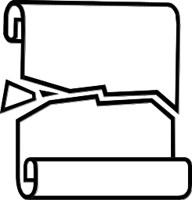
Partition
Algorithm partition(S, p)
Input sequence S, position p of pivot
Output subsequences L, E, G of the
elements of S less than, equal to,
or greater than the pivot, resp.
{ L, E, G = empty sequences;
x = S.remove(p);
while ( ¬S.isEmpty() )
{ y = S.remove(S.first());
if ( y < x )
L.insertLast(y);
else if ( y = x )
E.insertLast(y);
else // y > x
G.insertLast(y);}
return L, E, G;
}
We partition an input sequence as follows:
  We remove, in turn, each element y from S and
  We insert y into L, E or G, depending on the result of the comparison with the pivot x
Each insertion and removal is at the beginning or at the end of a sequence, and hence takes O(1) time
Thus, the partition step of quick-sort takes O(n) time

Slide 28




Quick-Sort Tree
An execution of quick-sort is depicted by a binary tree
  Each node represents a recursive call of quick-sort and stores
    Unsorted sequence before the execution and its pivot
    Sorted sequence at the end of the execution
  The root is the initial call
  The leaves are calls on subsequences of size 0 or 1
7 4 9 6 2 → 2 4 6 7 9
4 2 → 2 4
7 9 → 7 9
2 → 2
4 → 4
7 → 7
9 → 9

Slide 29
Execution Example (1/7)
Pivot selection
7 2 9 4 3 7 6 1 → 1 2 3 4 6 7 8 9
7 2 9 4 → 2 4 7 9
3 8 6 1 → 1 3 8 6
2 → 2
9 4 → 4 9
3 → 3
8 → 8
9 → 9
4 → 4

Slide 30
Execution Example (2/7)
Partition, recursive call, pivot selection
7 2 9 4 3 7 6 1 → 1 2 3 4 6 7 8 9
2 4 3 1 → 2 4 7 9
3 8 6 1 → 1 3 8 6
2 → 2
9 4 → 4 9
3 → 3
8 → 8
9 → 9
4 → 4

Slide 31

Execution Example (3/7)
Partition, recursive call, base case
7 2 9 4 3 7 6 1 → → 1 2 3 4 6 7 8 9
2 4 3 1 →→ 2 4 7
3 8 6 1 → 1 3 8 6
1 → 1
9 4 → 4 9
3 → 3
8 → 8
9 → 9
4 → 4

Slide 32



Execution Example (4/7)
Recursive call, …, base case, join
7 2 9 4 3 7 6 1 → 1 2 3 4 6 7 8 9
2 4 3 1 → 1 2 3 4
3 8 6 1 → 1 3 8 6
1 → 1
4 3 → 3 4
3 → 3
8 → 8
4 → 4

Slide 33
Execution Example (5/7)
Recursive call, pivot selection
7 2 9 4 3 7 6 1 → 1 2 3 4 6 7 8 9
2 4 3 1 → 1 2 3 4
7 9 7 1 → 1 3 8 6
1 → 1
4 3 → 3 4
8 → 8
9 → 9
4 → 4

Slide 34


Execution Example (6/7)
Partition, …, recursive call, base case
7 2 9 4 3 7 6 1 → 1 2 3 4 6 7 8 9
2 4 3 1 → 1 2 3 4
7 9 7 1 → 1 3 8 6
1 → 1
4 3 → 3 4
9 → 9
4 → 4

Slide 35


Execution Example (7/7)
Join, join
7 2 9 4 3 7 6 1 → 1 2 3 4 6 7 7 9
2 4 3 1 → 1 2 3 4
7 9 7 → 17 7 9
1 → 1
4 3 → 3 4
9 → 9
9 → 9
4 → 4

Slide 36
Worst-case Running Time
The worst case for quick-sort occurs when the pivot is the unique minimum or maximum element
One of L and G has size n − 1 and the other has size 0
The running time is proportional to the sum
n + (n − 1) + … + 2 + 1
Thus, the worst-case running time of quick-sort is O(n²)
depth | time
0 | n
1 | n − 1
… | …
n − 1 | 1
…

Slide 37
Expected Running Time (1/2)
Consider a recursive call of quick-sort on a sequence of size s
  Good call: the sizes of L and G are each less than 3s/4
  Bad call: one of L and G has size greater than 3s/4
A call is good with probability 1/2
  1/2 of the possible pivots cause good calls:
7 2 9 4 3 7 6 1 9
7 2 9 4 3 7 6 1
2 4 3 1
7 9 7 1 → 1
1
7 2 9 4 3 7 6
Good call
Bad call
1 2 3 4 5 6 7 8 9 10 11 12 13 14 15 16
Bad pivots
Good pivots
Bad pivots

Slide 38
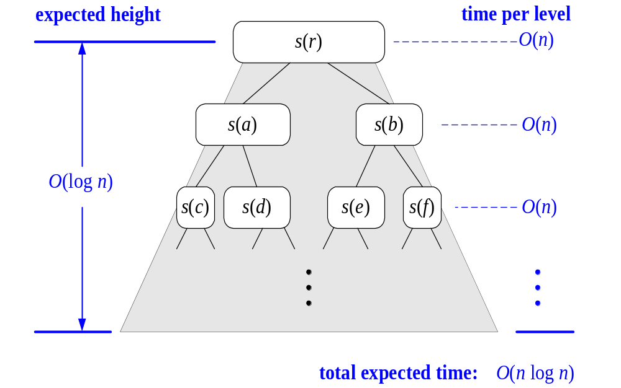
Expected Running Time (2/2)
Probabilistic Fact: The expected number of coin tosses required in order to get k heads is 2k
For a node of depth i, we expect
  i/2 ancestors are good calls
  The size of the input sequence for the current call is at most (3/4)^{i/2}n
Therefore, we have
  For a node of depth 2log_{4/3}n, the expected input size is one
  The expected height of the quick-sort tree is O(log n)
The amount or work done at the nodes of the same depth is O(n)
Thus, the expected running time of quick-sort is O(n log n)

Slide 39

In-Place Quick-Sort
Quick-sort can be implemented to run in-place
In the partition step, we rearrange the elements of the input sequence such that
  the elements less than the pivot have indices less than p
  the elements equal to or greater than the pivot have indices between p+1 and r
The recursive calls consider
  elements with indices less than p.
  elements with indices greater than p
Algorithm inPlaceQuickSort(S, l, r)
Input sequence S, indices l and r of
the first and last elements
Output sequence S with the
elements of indices between l and r
rearranged in increasing order
{ if l ≥ r
return;
k = a random integer between l and r;
pivot=S[k];
Swap pivot and S[r];
// pivot is the last element now
p = inPlacePartition();
inPlaceQuickSort(S, l, p-1);
inPlaceQuickSort(S, p+1, r);
}

Slide 40
In-Place Partitioning (1/3)
inPlacePartition()
{ left = l; // scan right to locate the end of G U E
right = r; // scan left to locate the end of L
while left < right
{
while left < right and S[left] < pivot
left ++; // insert into L
while left < right and S[right] ≥ pivot
right --; // insert into G
if left < right
Swap S[left] and S[right];
}
Swap S[left] and pivot;
return left;
}

Slide 41
In-Place Partitioning (2/3)
Perform the partition using two indices to split S into L and E U G (a similar method can split E U G into E and G).
Repeat until left and right meet:
  Scan left to the right until finding an element > pivot.
  Scan right to the left until finding an element < pivot.
  Swap elements at indices left and right
left
right
3 2 5 1 0 7 3 5 9 2 7 9 8 9 7 9 6
(pivot = 6)
left
right
3 2 5 1 0 7 3 5 9 2 7 9 8 9 7 9 6

Slide 42
In-Place Partitioning (2/3)
Swap the element at left and pivot
right
3 2 5 1 0 2 3 5 9 7 7 9 8 9 7 9 6
left
3 2 5 1 0 2 3 5 6 7 7 9 8 9 7 9 9

Slide 43
Summary of Sorting Algorithms
Algorithm | Time | Notes
selection-sort | O(n²) | in-place slow (good for small inputs)
insertion-sort | O(n²) | in-place slow (good for small inputs)
quick-sort | O(n log n) expected | in-place, randomized fastest (good for large inputs)
heap-sort | O(n log n) | in-place fast (good for large inputs)
merge-sort | O(n log n) | sequential data access fast (good for huge inputs)

Slide 44
Bucket-Sort and Radix-Sort
1, c
3, a
3, b
7, d
7, g
7, e
∅
∅
∅
∅
∅
∅
∅
B
0
1
2
3
4
5
6
7
8
9

Slide 45

Bucket-Sort
Let be S be a sequence of n (key, value) entries with keys in the range [0, N − 1]
Bucket-sort uses the keys as indices into an auxiliary array B of sequences (buckets)
  Phase 1: Empty sequence S by moving each entry (k, o) into its bucket B[k]
  Phase 2: For i = 0, …, N − 1, move the entries of bucket B[i] to the end of sequence S
Analysis:
  Phase 1 takes O(n) time
  Phase 2 takes O(n + N) time
Bucket-sort takes O(n + N) time
Algorithm bucketSort(S, N)
Input sequence S of (key, value)
items with keys in the range [0, N − 1]
Output sequence S sorted by increasing
keys
{ B = array of N empty sequences;
while ( ¬ isEmpty(S )
{ f = first(S);
(k, o) = remove(S, f);
insertLast(B[k], (k, o)); }
for ( i = 0; i++; i <=N − 1)
while ( ¬ isEmpty(B[i])
{ f = first(B[i]);
(k, o) = remove(B[i], f);
insertLast(S, (k, o)); }
}

Slide 46

Example
Key range [0, 9]
7, d
1, c
3, a
7, g
3, b
7, e
Phase 1
1, c
3, a
3, b
7, d
7, g
7, e
B
0
1
2
3
4
5
6
7
8
9
∅
∅
∅
∅
∅
∅
∅
Phase 2
1, c
3, a
3, b
7, d
7, g
7, e

Slide 47

Properties and Extensions
Key-type Property
  The keys are used as indices into an array and cannot be arbitrary objects
Stable Sort Property
  The relative order of any two items with the same key is preserved after the execution of the algorithm
Extensions
  Integer keys in the range [a, b]
    Put entry (k, o) into bucket
    B[k − a]
  String keys from a set D of possible strings, where D has constant size (e.g., names of the 50 U.S. states)
    Sort D and compute the rank r(k) of each string k of D in the sorted sequence
    Put entry (k, o) into bucket
    B[r(k)]

Slide 48

Lexicographic Order
A d-tuple is a sequence of d keys (k₁, k₂, …, k_{d}), where key k_{i} is said to be the i-th dimension of the tuple
Example:
  The Cartesian coordinates of a point in space are a 3-tuple
The lexicographic order of two d-tuples is recursively defined as follows
(x₁, x₂, …, x_{d}) < (y₁, y₂, …, y_{d})
⇔
x₁ < y₁ ∨ x₁ = y₁ ∧ (x₂, …, x_{d}) < (y₂, …, y_{d})
i.e., the tuples are compared by the first dimension, then by the second dimension, etc.

Slide 49
Lexicographic-Sort
Let stableSort(S) be a stable sorting algorithm
Lexicographic-sort sorts a sequence of d-tuples in lexicographic order by executing d times algorithm stableSort, one per dimension, from least significant element to most significant element
Lexicographic-sort runs in O(dT(n)) time, where T(n) is the running time of stableSort
Algorithm lexicographicSort(S)
Input sequence S of d-tuples
Output sequence S sorted in
lexicographic order
{ for ( i = d; i >=1; i- -; )
stableSort(S, i);
}
Example:
(7,4,6) (5,1,5) (2,4,6) (2, 1, 4) (3, 2, 4)
(2, 1, 4) (3, 2, 4) (5,1,5) (7,4,6) (2,4,6)
(2, 1, 4) (5,1,5) (3, 2, 4) (7,4,6) (2,4,6)
(2, 1, 4) (2,4,6) (3, 2, 4) (5,1,5) (7,4,6)

Slide 50
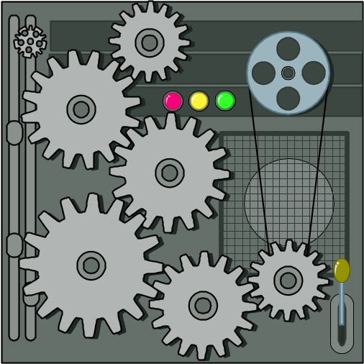
Radix-Sort
Radix-sort is a specialization of lexicographic-sort that uses bucket-sort as the stable sorting algorithm in each dimension
Radix-sort is applicable to tuples where the keys in each dimension i are integers in the range [0, N − 1]
Radix-sort runs in time O(d( n + N))
Algorithm radixSort(S, N)
Input sequence S of d-tuples such
that (0, …, 0) ≤ (x₁, …, x_{d}) and
(x₁, …, x_{d}) ≤ (N − 1, …, N − 1)
for each tuple (x₁, …, x_{d}) in S
Output sequence S sorted in
lexicographic order
{ for ( i = d; i>=1; i-- )
bucketSort(S, N);
}

Slide 51

Radix-Sort for Binary Numbers
Consider a sequence of n b-bit integers
x = x_{b − 1} … x₁x₀
We represent each element as a b-tuple of integers in the range [0, 1] and apply radix-sort with N = 2
This application of the radix-sort algorithm runs in O(bn) time
For example, we can sort a sequence of 32-bit integers in linear time
Algorithm binaryRadixSort(S)
Input sequence S of b-bit
integers
Output sequence S sorted
replace each element x
of S with the item (0, x)
{ for ( i = 0; i<= b−1; i++ )
{ replace the key k of
each item (k, x) of S with bit x_{i} of x;
bucketSort(S, 2);
}
}

Slide 52
Example
Sorting a sequence of 4-bit integers
1001
0010
1001
1001
0001
0010
1110
1101
0001
0010
1101
1001
0001
0010
1001
0001
1101
0010
1101
1101
1110
0001
1110
1110
1110

Slide 53

Sorting Lower Bound

Slide 54

Comparison-Based Sorting
Many sorting algorithms are comparison based.
  They sort by making comparisons between pairs of objects
  Examples: bubble-sort, selection-sort, insertion-sort, heap-sort, merge-sort, quick-sort, ...
Let us therefore derive a lower bound on the running time of any algorithm that uses comparisons to sort n elements, x₁, x₂, …, x_{n}.
Is x_{i} < x_{j}?
no
yes

Slide 55
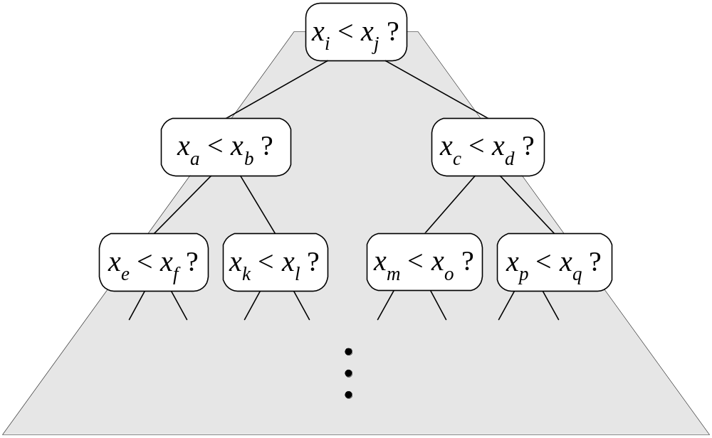
Counting Comparisons
Let us just count comparisons then.
Each possible run of the algorithm corresponds to a root-to-leaf path in a decision tree

Slide 56
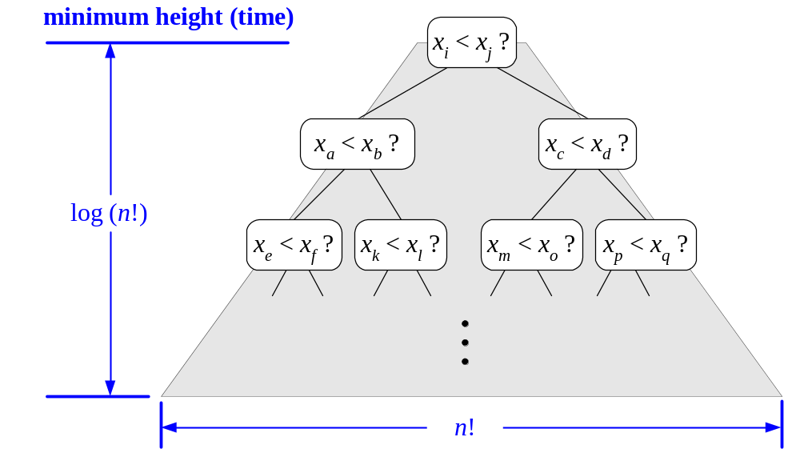
Decision Tree Height
The height of this decision tree is a lower bound on the running time
Every possible input permutation must lead to a separate leaf output.
  If not, some input …4…5… would have same output ordering as …5…4…, which would be wrong.
Since there are n!=1*2*…*n leaves, the height is at least log (n!)

Slide 57

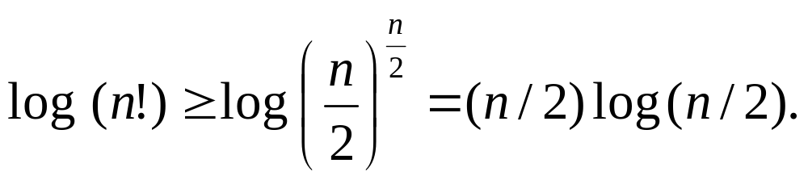
The Lower Bound
Any comparison-based sorting algorithms takes at least log (n!) time
Therefore, any such algorithm takes time at least
That is, any comparison-based sorting algorithm must run in Ω(n log n) time.

Slide 58
Summary
Merge sort
Quick sort
Lexicographic sort
Bucket sort
Radix sort
Suggested reading:
Sedgewick, Chapters 7, 8, 10

